Slide 1
Hadoop 2.0 (YARN)
Notes:
‹#›

Slide 2
Agenda
Recap of Hadoop 1.0 architecture
Job scheduling in Hadoop 1.0 and its limitations
Hadoop 2.0 (YARN) and its salient features
Architectural overview of Hadoop 2.0
Notes:
‹#›

Slide 3
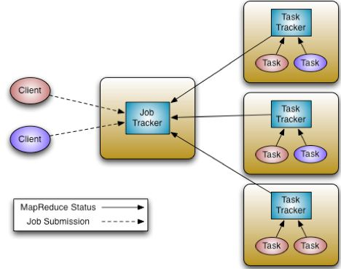
Job tracker (centralized scheduler in Hadoop 1.0)
Notes:
‹#›

Slide 4
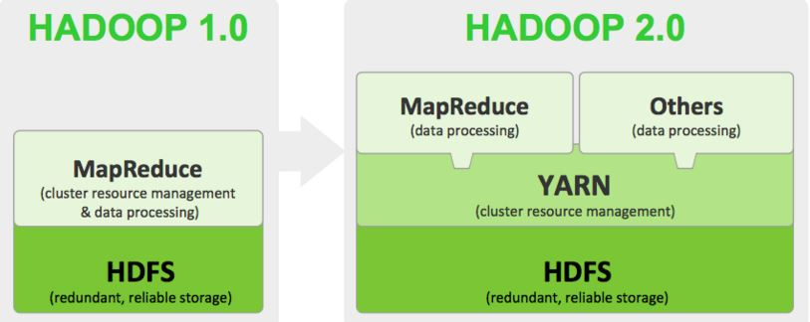

YARN: Yet another resource negotiator
YARN (Hadoop 2.0) is the new scheduler and centralized resource manager in the cluster.
It replaces the Job tracker in Hadoop 2.0
The started back in 2012 as an apache sub project and a beta version was relased in mid 2013
stable versions became available from 2014 onwards
Notes:
‹#›

Slide 5
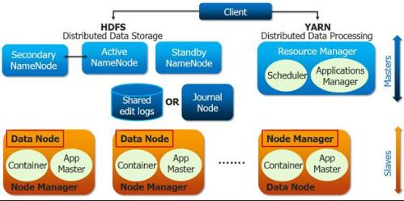

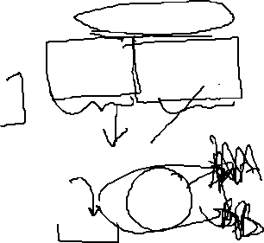

Components of YARN
Its a 2 tiered model with some components (deamons) in master mode and some
operating in slave mode.
Resource manager works in master mode (runs on a dedicated hardware in production setup)
Node manager works in slave mode & its services are run in the data nodes.
Resource manager comprises of 2 components
1)Scheduler
2)Applications Manager
Node manager consists of a container (an encapsulation of resources for running a job) and an app
Master (application master)
Notes:
‹#›

